Slide 1


The Project quantifies and measures ongoing water conservation efforts within the 15-county Region H area of Texas.

Slide 2
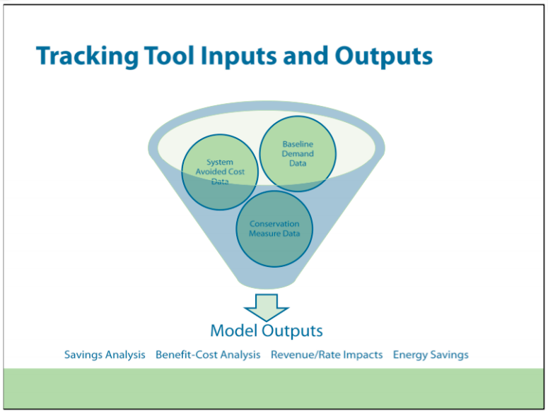
The Water Conservation Tracking Tool utilizes data inputs that include system demands, avoided costs, and water conservation activities.
The Tracking Tool outputs allow the user to identify cost-effective programs, savings potential, the impact to the utility’s revenue requirement, and energy and greenhouse gas reductions.

Slide 3
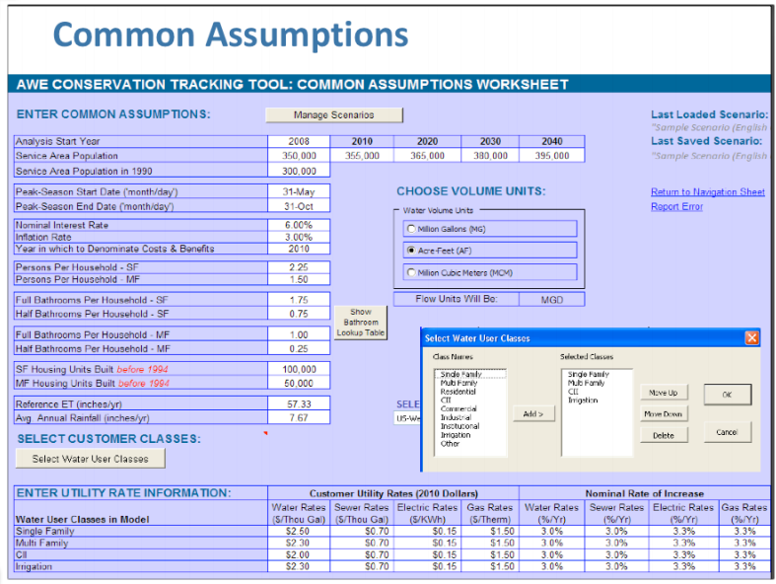
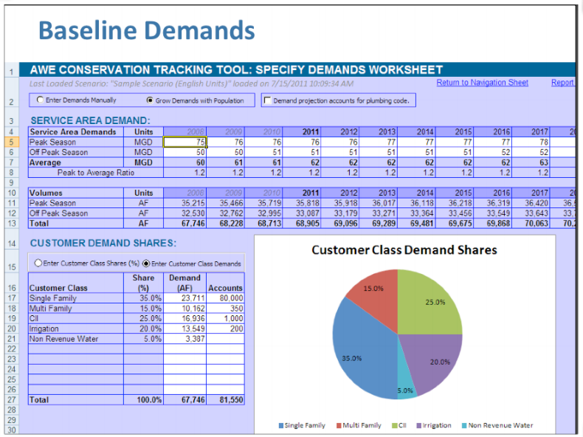

Slide 4
Planned Water Tracker Architecture:
Models – Rails
Views – Rails views plus HTML, CSS & JS
Controllers – Rails
MySQL database
Actual Water Tracker Architecture:
Client Only – HTML, CSS & JS
Bootstrap (Material Admin theme) & Bootgrid
Data stored as local JSON files

Slide 5
Challenges:
Learning new technology
Rails
Bootstrap
Material Admin theme
Integrating Bootstrap theme with Rails
Controlling dependent asynchronous functions
Lessons Learned:
Bootstrap is great
Bootgrid is even better
Data stored as local JSON files

Slide 6
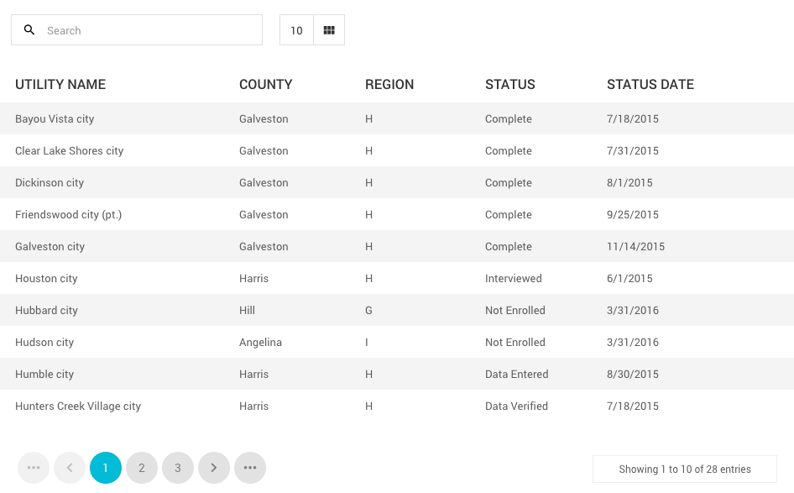
<div class="table-responsive">
<table id="data-table-basic" class="table table-striped">
</table>
</div>
Bootgrid Example

